Slide 1



SALES ANALYSIS
Data Analyst Specialist
ONL4_DAT1_S7
1

Slide 2

Presented by:
Basmala Mohamed
Mariam Belal
Sohaila Yasser
Ola Elnaggar
Ahmed Elabyad
Ramez Remon
Supervised by:
Eng. Ahmed Samir
2

Slide 3
AGENDA
Introduction
Data Cleaning
Exploratory Data Analysis & Analysis Questions
Data Visualization
Prediction
Conclusion & Recommendations
3

Slide 4




Used Tools
Microsoft Excel
SQL
Python
Tableau
Power BI
​Conducted preliminary data profiling to identify missing values and duplicate rows.
​Executed Data Normalization by breaking down the single flat Superstore sheet into structured tables.
​Utilized Power Query to clean and shape the newly normalized data schemas.
Imported the normalized Excel tables into structured relational databases (Orders, Customers, Products).
​Enforced data integrity by defining optimal Primary Keys and Foreign Keys between tables.
​Wrote efficient SQL queries and joins to retrieve consolidated datasets for analysis.
​Handled data wrangling, missing values, and data type conversions using Pandas.
​Performed exploratory data analysis (EDA) to understand sales distributions.
​Conducted detailed statistical analysis to extract key performance trends.
Built interactive dynamic dashboards focusing on Shipping, product, and customer metrics.
​Designed advanced visual layouts using trend lines and custom KPI cards.
​Implemented flexible sorting, axis swapping, and granular filtering options.
Formulated dynamic calculated columns and sales metrics using DAX expressions.
​Built interactive dynamic dashboards focusing on Shipping, product, and customer metrics.
​Designed standardized, brand-consistent canvases to display executive insights.
Visuals
4
Cleaning & Analysis

Slide 5
Project Objective
Analyze sales data to understand:
​​
​
Sales and profit distributions across regions
Most profitable product categories and segments
Customer purchasing behaviors and patterns
Why?
Understanding these insights is essential for optimizing inventory management, driving revenue growth, and improving overall business efficiency.
5

Slide 6
Dataset Summary
Sheets
Calculated Columns
From One Sheet to Six Related Tables
Customers
Products
Locations
Orders
Order Details
Profit Margin
Cost
Shipping Days
6

Slide 7
Data Cleaning
Why?
The data cleaning process was performed to ensure the dataset was accurate, consistent, and ready for analysis. I checked for missing values, verified data types, and removed any exact duplicate records. I also investigated duplicate IDs to maintain data integrity. Since the Superstore dataset contains multiple products within the same order, repeated Order IDs were expected and considered valid rather than errors. Data formatting was standardized, and the dataset was reviewed for inconsistencies to ensure reliable analysis and accurate dashboard results.
7

Slide 8
Steps of Cleaning
Step 4
Step 2
Step 1
Step 3
Data Normalization
Data Transformation
Handling Missig Values
Removing Duplicates
8

Slide 9
Step 1: Data Normalization
Split the original dataset into multiple related tables:
Customers | Products | Locations | Orders | Order Details
Improved data integrity.
Reduced data redundancy.
Simplified database maintenance.
Enhanced SQL query performance.
Organized the database more efficiently.
Made data analysis more accurate and efficient.
8

Slide 10
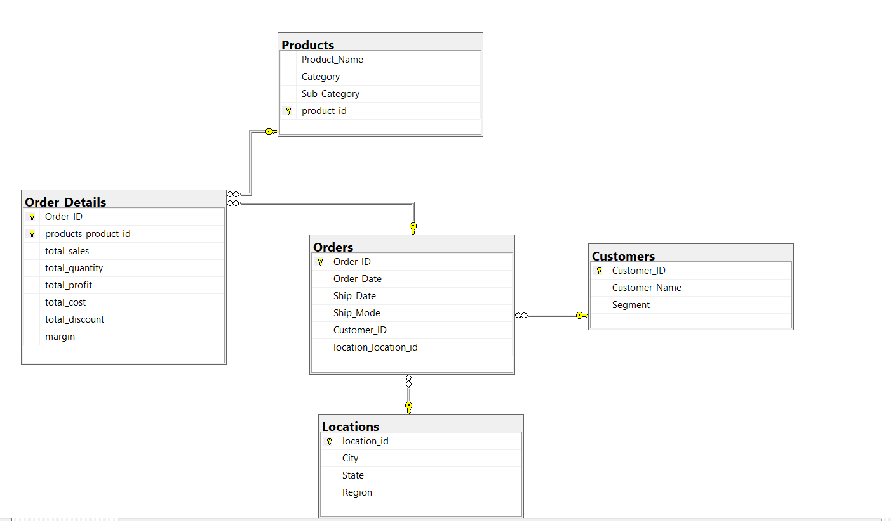
Dataset Model
9

Slide 11
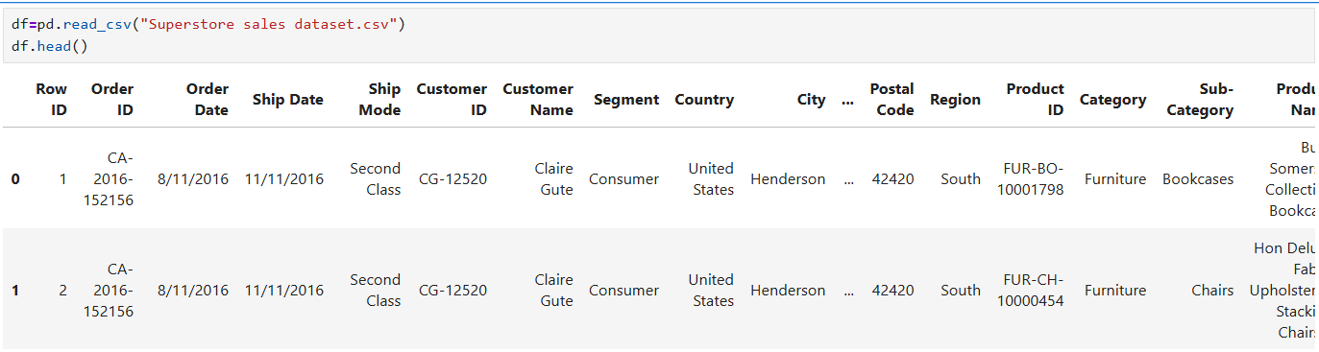
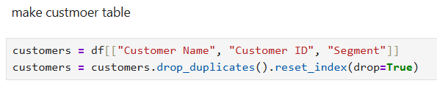
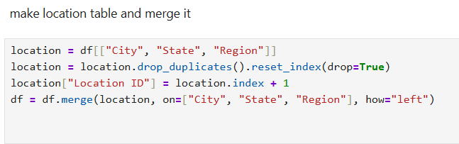
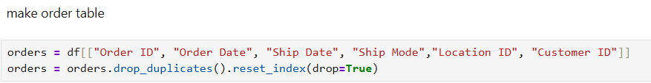
10

Slide 12
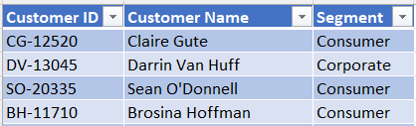
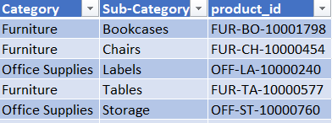
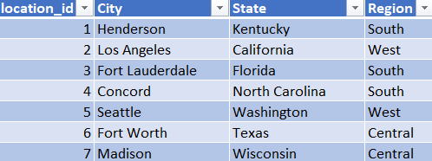
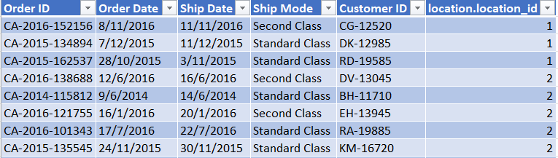
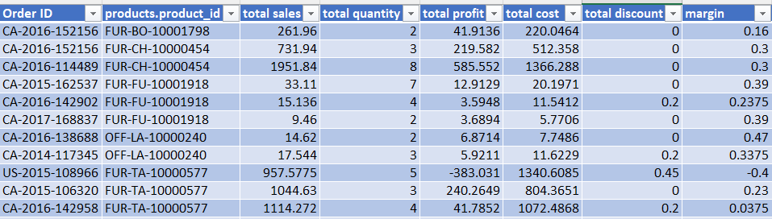
11

Slide 13
Step 2: Data Transformations
Converted data types to the appropriate formats.
Standardized data formats for consistency.
Created calculated fields where needed.
Formatted date fields to support time-based analysis.
Structured the data for efficient SQL queries.
Ensured the dataset was consistent and analysis-ready.
Improved the accuracy of business insights.
12

Slide 14
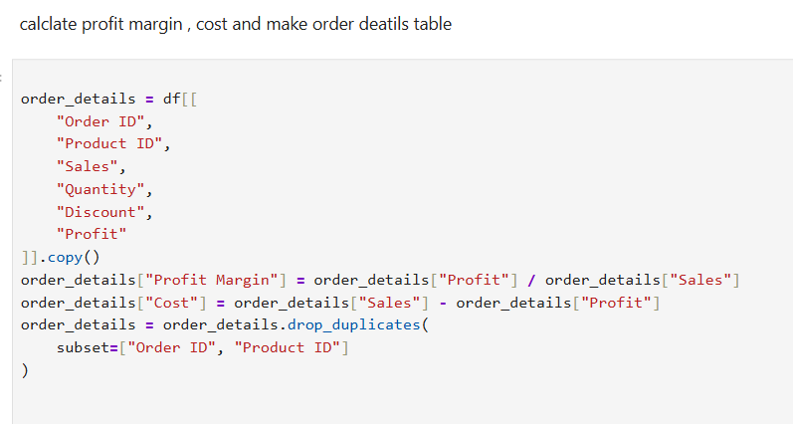

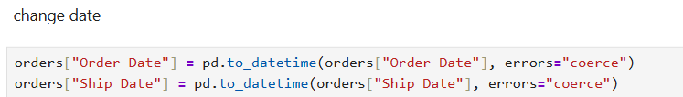
13

Slide 15
Step 3: Handling Missing Values
Identified missing and incomplete values.
Reviewed missing data to ensure data quality.
Handled missing values based on their impact on the analysis.
Improved data accuracy and consistency.
Increased the reliability of the dataset.
Prepared the dataset for SQL analysis and Tableau dashboards.
14

Slide 16
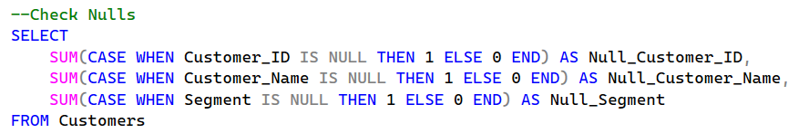
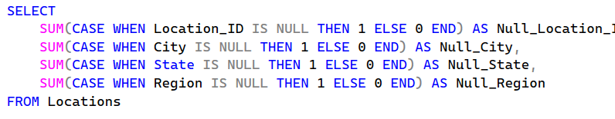
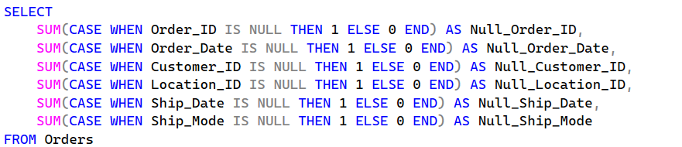
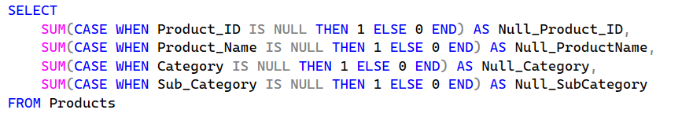
15

Slide 17
Step 4: Removing Duplicates
Checked the dataset for duplicate records.
Removed exact duplicate rows.
Verified duplicate Order IDs and retained valid records (multiple products in the same order).
Verified duplicate Customer IDs and retained valid records (repeat purchases by the same customer).
Verified repeated Product IDs for the same products and retained valid records (products appearing in multiple orders).
Maintained data accuracy and integrity.
Ensured the dataset was reliable and ready for analysis.
16

Slide 18
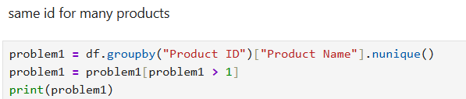
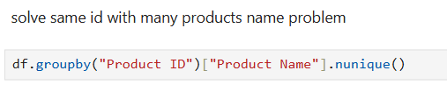
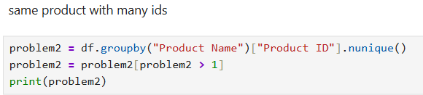
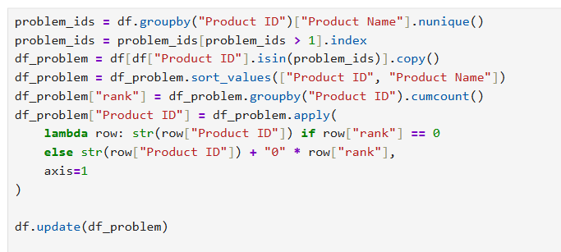
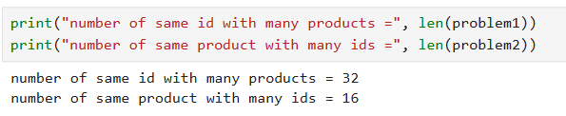
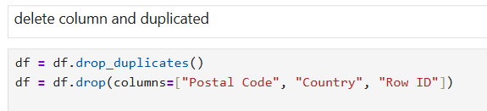
17

Slide 19
Exploratory Data Analysis(EDA)
Why?
The data analysis phase was conducted to explore the dataset, identify trends and patterns, evaluate sales performance across different dimensions, and generate actionable business insights. This step also helped define the KPIs and visualizations used in the final Tableau dashboard
18

Slide 20
Analysis Overview
Customers & Orders Analysis
Shipping analysis
Sales Analysis
Products Analysis
19

Slide 21
Analysis Questions
Customers & Orders Analysis
Top 10 customers by num of orders( Loyalty customers)
Segment Performance by Sales, Profit
Num of orders per Segment
Ship Mode Performance
Orders per Regions
20

Slide 22
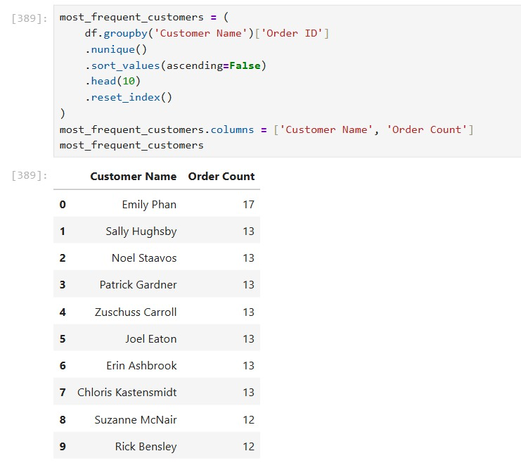
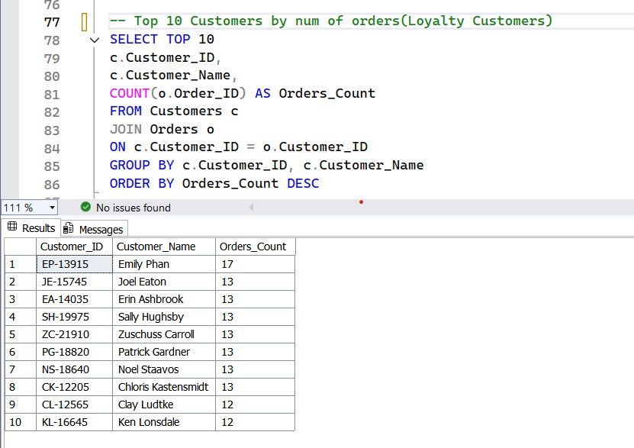
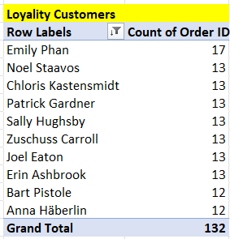
Top 10 customers by num of orders( Loyalty customers)
21

Slide 23
Analysis Questions
Products Analysis :
Top 10 Most Sold Products by Quantity and Sales
Products with High Sales but Negative Profit
Category Performance by Sales and Profit
Sub-Categories by Sales and Profit
22

Slide 24
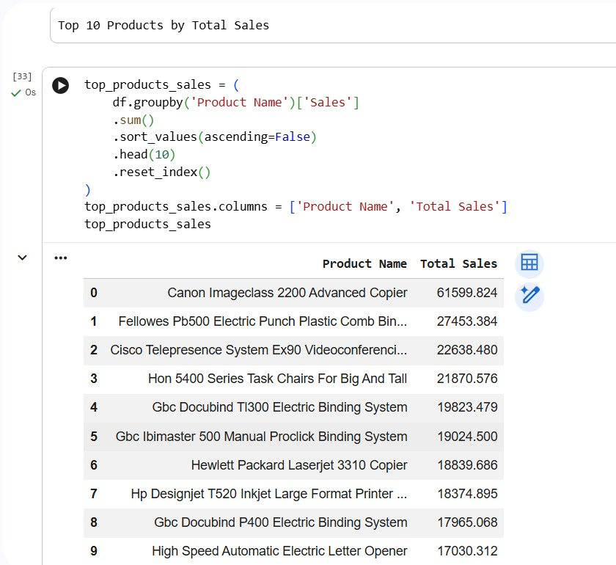
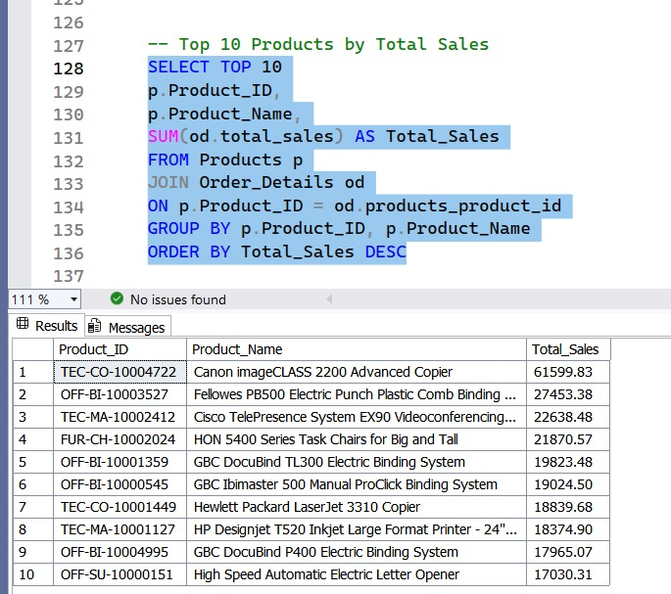
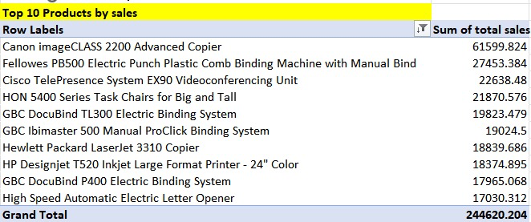
Top 10 Most Sold Products by Quantity and Sales
23

Slide 25
Analysis Questions
Sales Trend Analysis :
The trend of sales and profit over time (monthly/year)
Best year in sales
Sales per Quarter
24

Slide 26
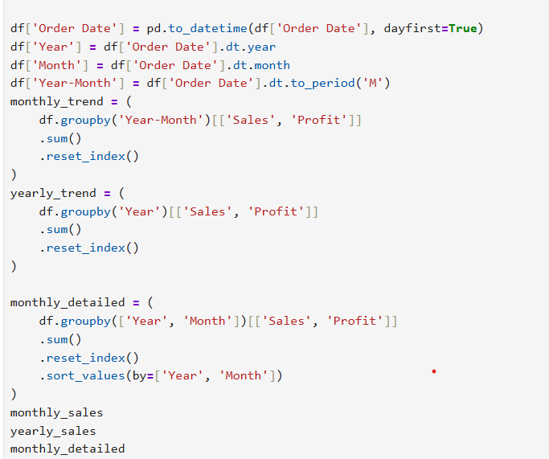
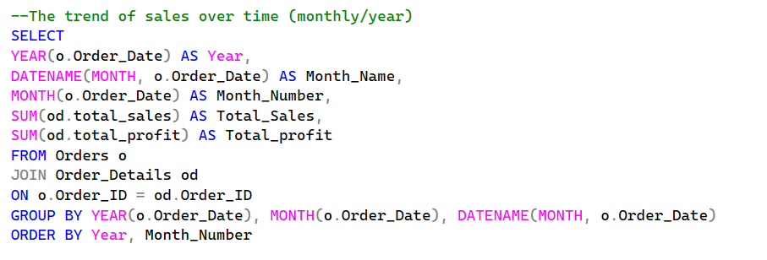
The trend of sales and profit over time (monthly/year)
25

Slide 27
Data Visualization
Built interactive dashboards to present key business insights.
Used charts, KPIs, and filters to simplify data analysis and support decision-making.
The project includes four dashboards:
Overview Dashboard
Customer & Orders Analysis
Product Analysis
Shipping & Delivery Performance
26

Slide 28
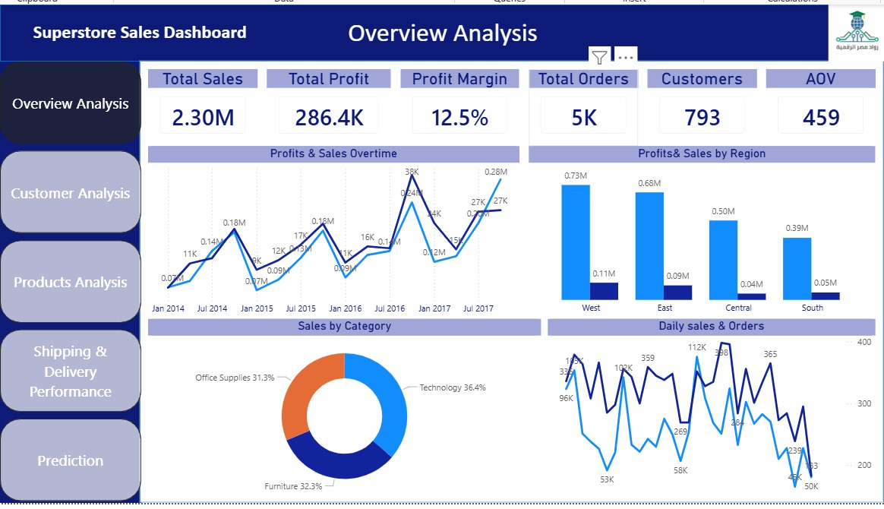
Power Bi
27

Slide 29
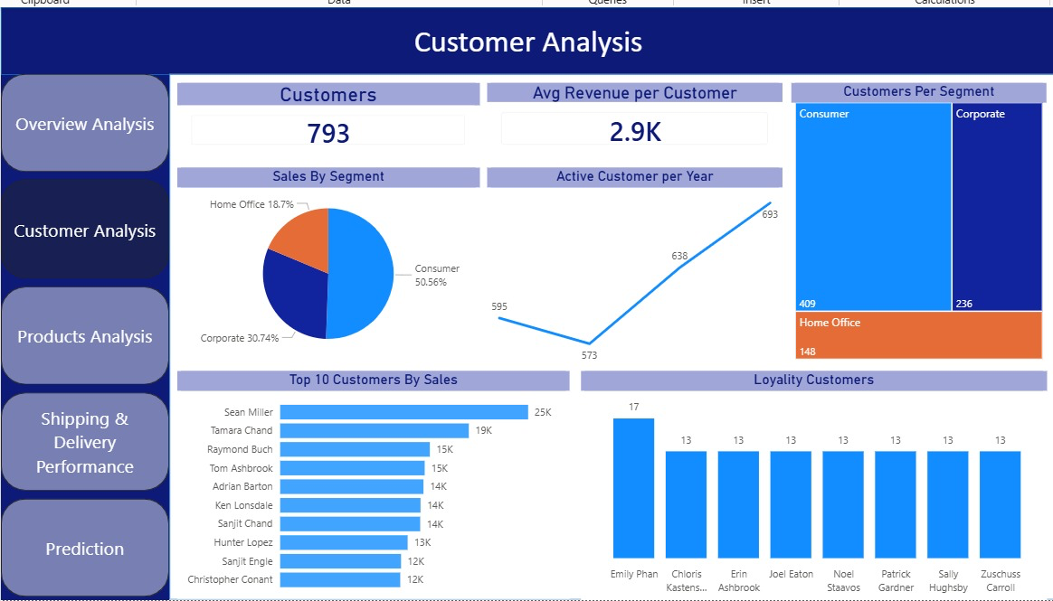
28

Slide 30
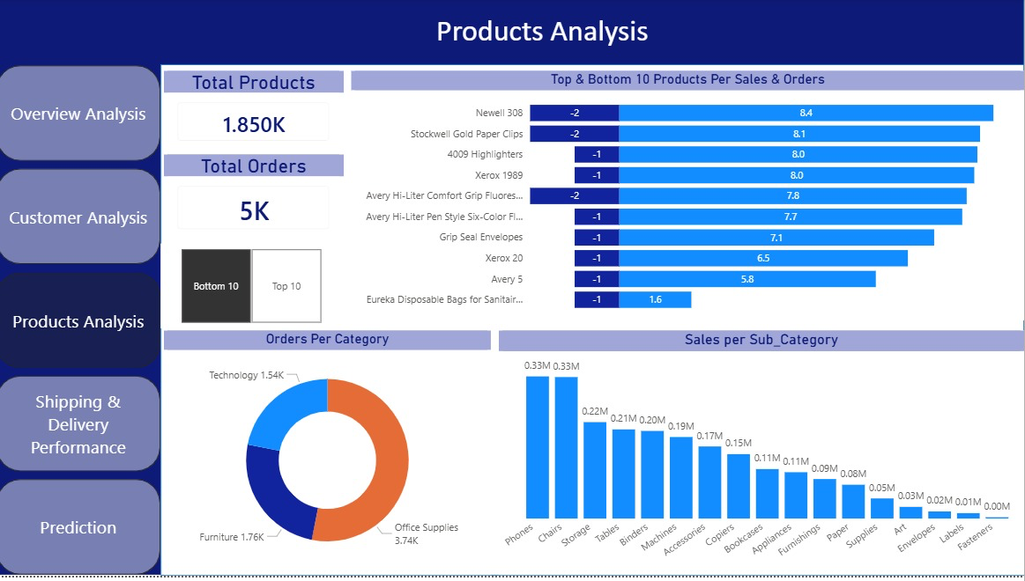
28
29

Slide 31
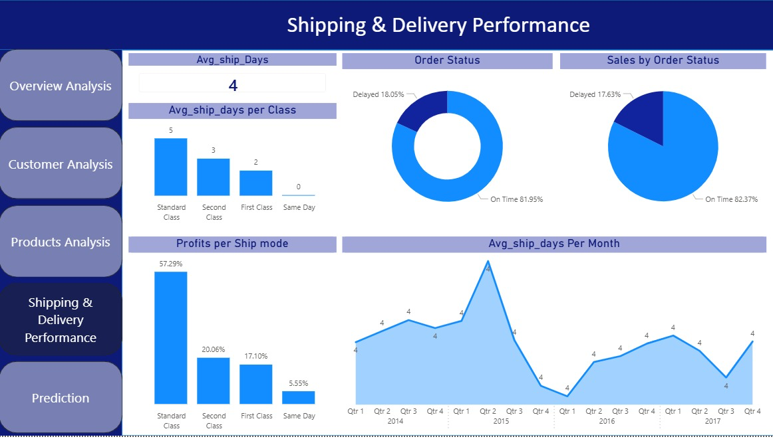
30

Slide 32
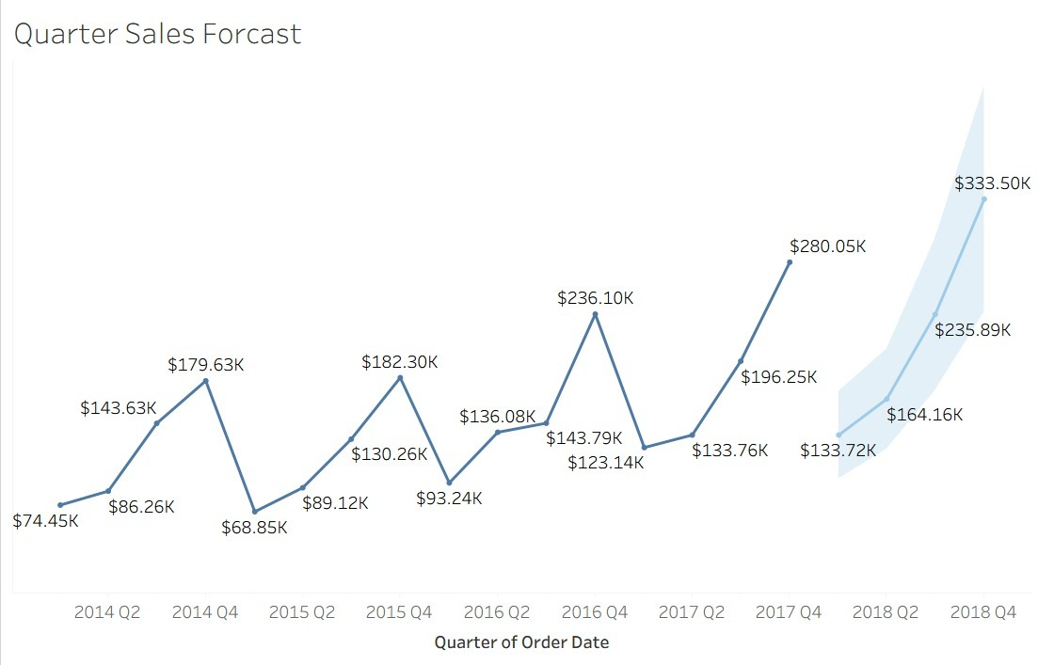
Prediction
31

Slide 33
💡 Key Actionable Recommendations:
​
​​Optimize Total Costs: Conduct an urgent review of supplier agreements and production costs to reduce the $2.01M expenditure and push the profit margin toward a healthier 15% – 18% target.
​Launch Acquisition Campaigns: Allocate a specific marketing budget focused entirely on acquiring new customers to boost the current 1.51% rate and expand market share.
​Fix Shipping Bottlenecks: Establish stricter agreements with shipping partners to lower the 30.76% delay rate, focusing heavily on the Central Region as it has the slowest delivery time (4 days).
​Rethink Same-Day Pricing: Increase the price of the Same-Day shipping service or optimize its logistics so that fast shipping yields a higher profit margin than standard options.
​Counter the Q1 Slump: Introduce aggressive promotional campaigns, bundles, or inventory clearance sales during the first quarter of the year to activate cash flow and avoid the seasonal drop.
​Double Down on High-Value Items: Increase inventory depth and product variety for Chairs and Phones to fully capitalize on the high market demand for these specific segments.
32

Slide 34
Project Repository:
All project files, source code, dashboards, and documentation are available on GitHub.
🔗 GitHub Repository:
https://github.com/Ahmedelabi/Insight-Pioneers
33

Slide 35

34

